Slide 1

WIPRO NGA Program – 25SUB4530_CP_JAVA
Capstone Project Presentation – 9th Feb & 10th Feb 2026
Project Title – Task/To-Do Management Application
Presented by – Varsha P R
Jayanth V L K
www.rpsconsulting.in

Slide 2
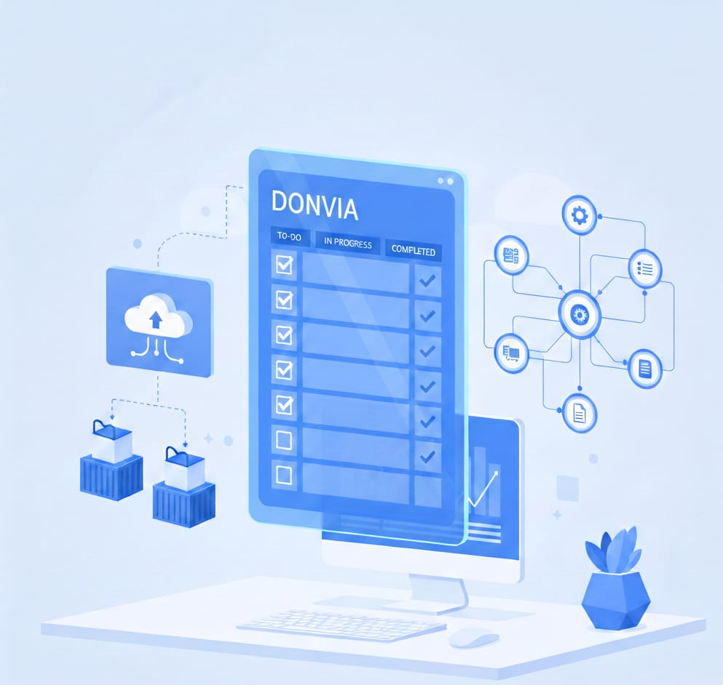

Objective of the Project
To allow users to create, update, and delete tasks easily
Track the task status as pending and completed
To store user and task data securely in a data base
Provide clear visibility of tasks
To demonstrate real-world full-stack development using Angular and Spring Boot.
To deploy the application using modern DevOps tools like Docker and Microsoft Azure.
2024 - RPS Consulting all rights reserved

Slide 3
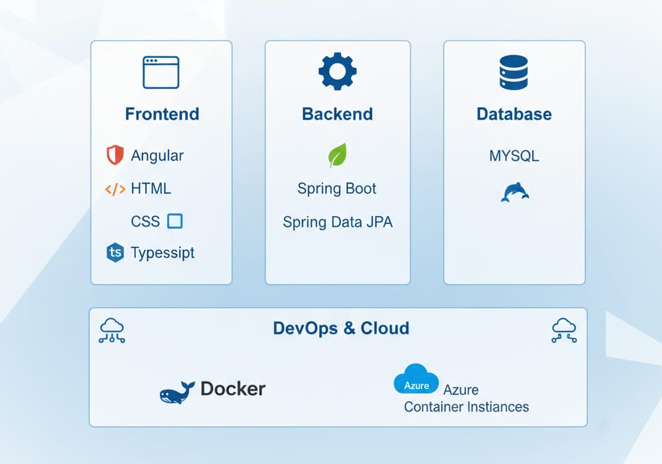
Technology Stack
Frontend:
Angular
HTML, CSS, TypeScript
Backend:
Spring Boot
Spring Data JPA
Database:
MySQL
DevOps & Cloud:
Docker
Azure Container Instances
2024 - RPS Consulting all rights reserved

Slide 4
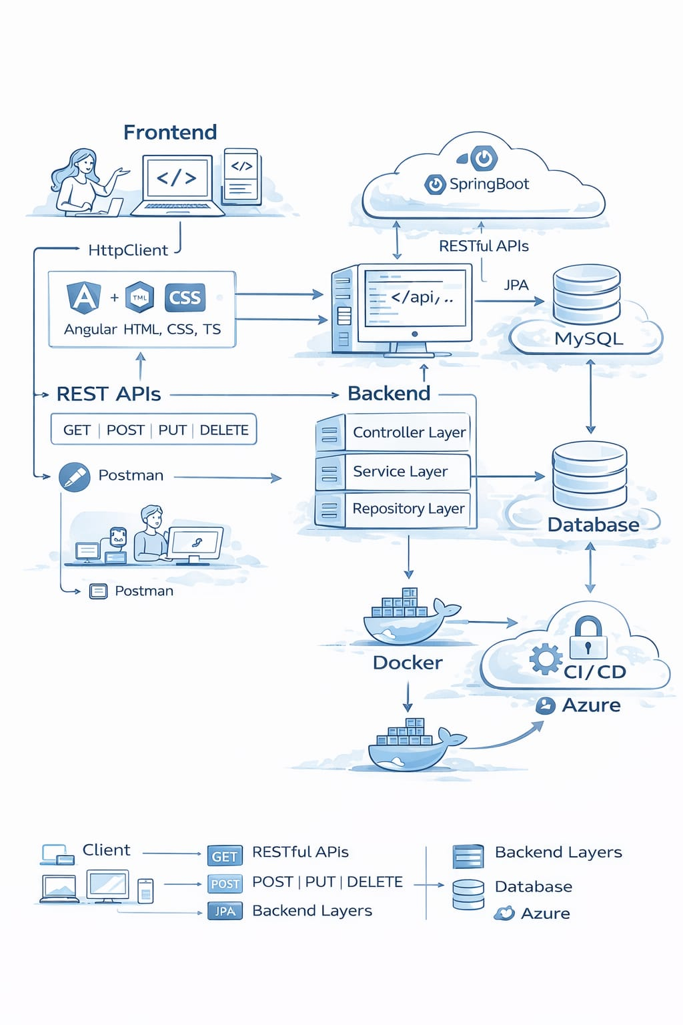
System Architecture
This project follows a client–server architecture where the Angular frontend acts as the client and the Spring Boot application acts as the server.
The communication between them is handled using REST APIs over HTTP.
Internally, the backend uses a layered architecture with controller, service, and repository layers, along with Spring Data JPA for database interaction.
The application is containerized using Docker to ensure environment consistency, and it is deployed on Azure using App Service with CI/CD enabled through GitHub Actions. This overall mechanism makes the application scalable, modular, and cloud-ready.
2024 - RPS Consulting all rights reserved

Slide 5
Core Functionalities
User login and authentication
Create new tasks
Edit existing tasks
Delete tasks
Mark tasks as Completed / Pending
Filter tasks by status
Sort tasks by due date
2024 - RPS Consulting all rights reserved

Slide 6
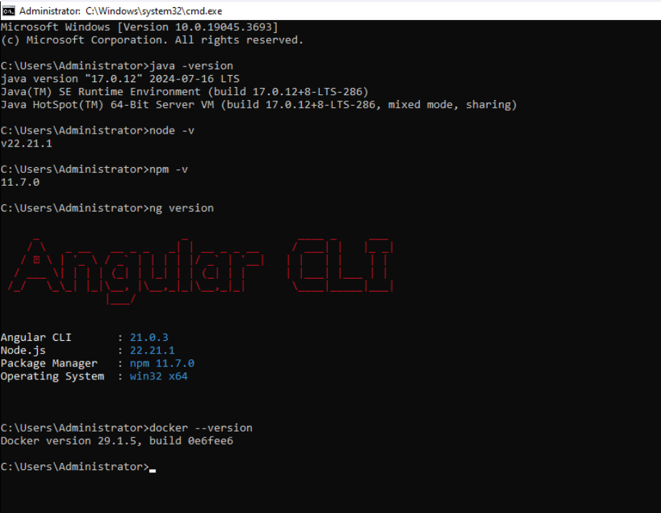
Backend and Frontend Versions
This picture represents the backend and frontend tool versions used in our project to ensure stability, compatibility, and smooth deployment.
2024 - RPS Consulting all rights reserved

Slide 7
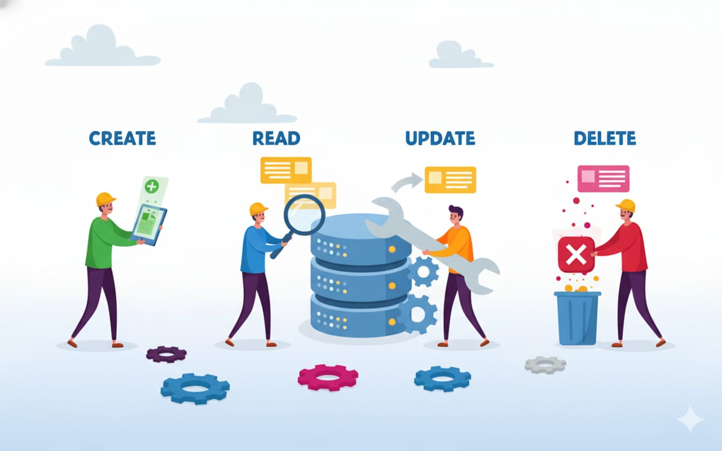
Backend Implementation
Developed using Spring Boot
REST APIs created for all CRUD operations
Controllers handle HTTP requests
Services contain business logic
Repositories interact with database
Uses Spring Data JPA for persistence
2024 - RPS Consulting all rights reserved

Slide 8
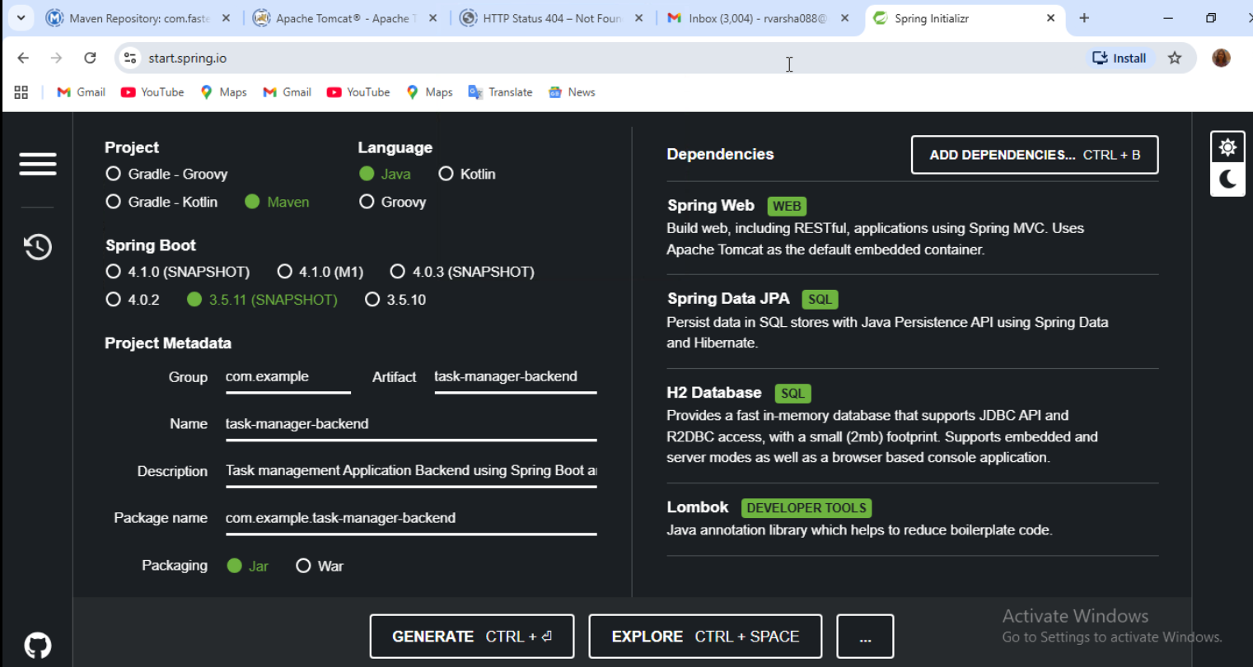
Backend Implementation
2024 - RPS Consulting all rights reserved

Slide 9
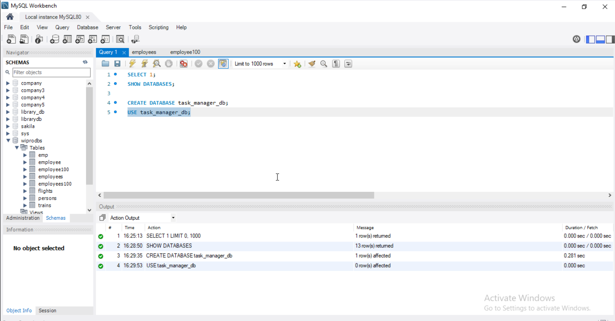
Backend Implementation
2024 - RPS Consulting all rights reserved

Slide 10
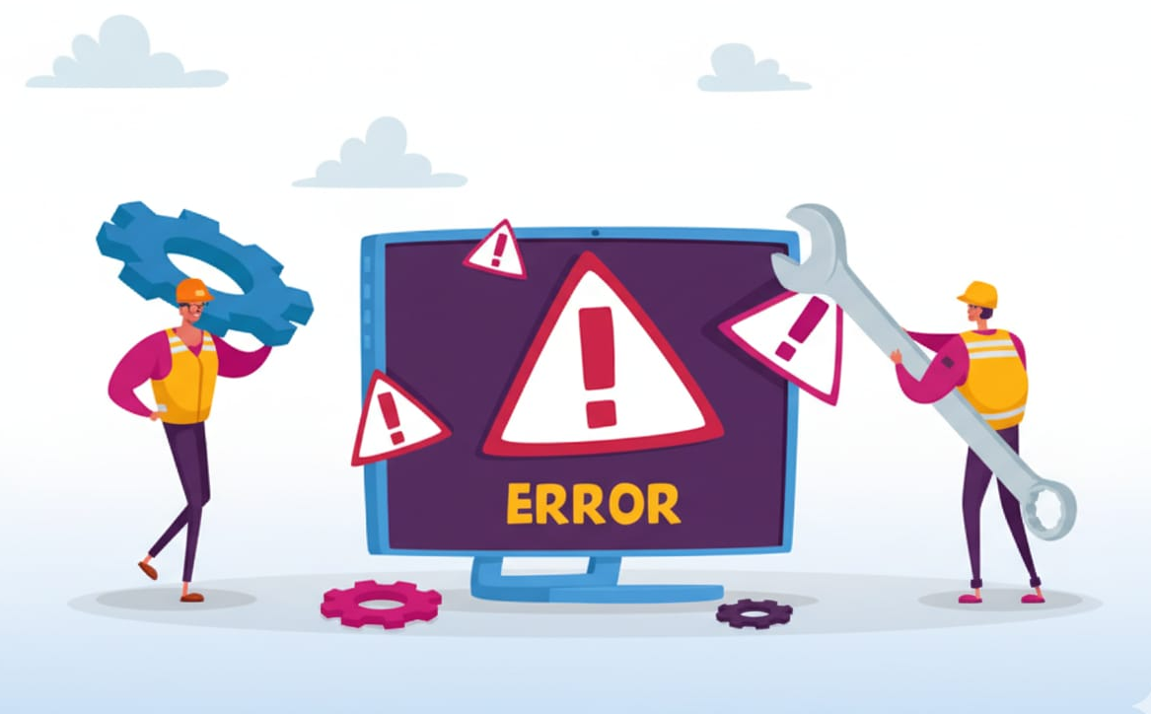
Global Exception Handling
Implemented using @ControllerAdvice
Handles exceptions globally
Provides meaningful error messages
Prevents application crash
Improves backend reliability and maintainability
2024 - RPS Consulting all rights reserved

Slide 11
Frontend Implementation
Developed using Angular
Responsive UI with clean layout
Forms for task creation and update
Filters for task status
Theme toggle (Light / Dark mode)
Communicates with backend using HttpClient
2024 - RPS Consulting all rights reserved

Slide 12
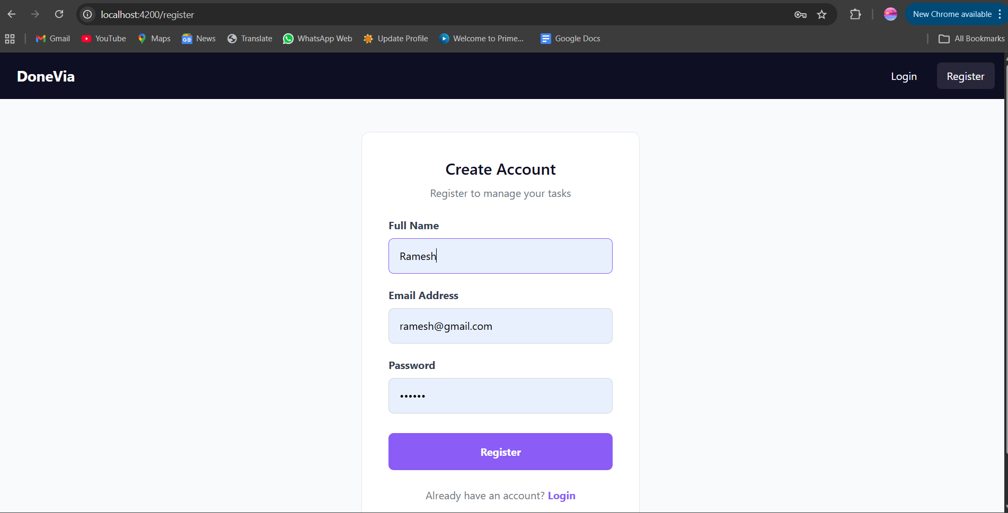
Frontend Implementation
Register Page
2024 - RPS Consulting all rights reserved

Slide 13
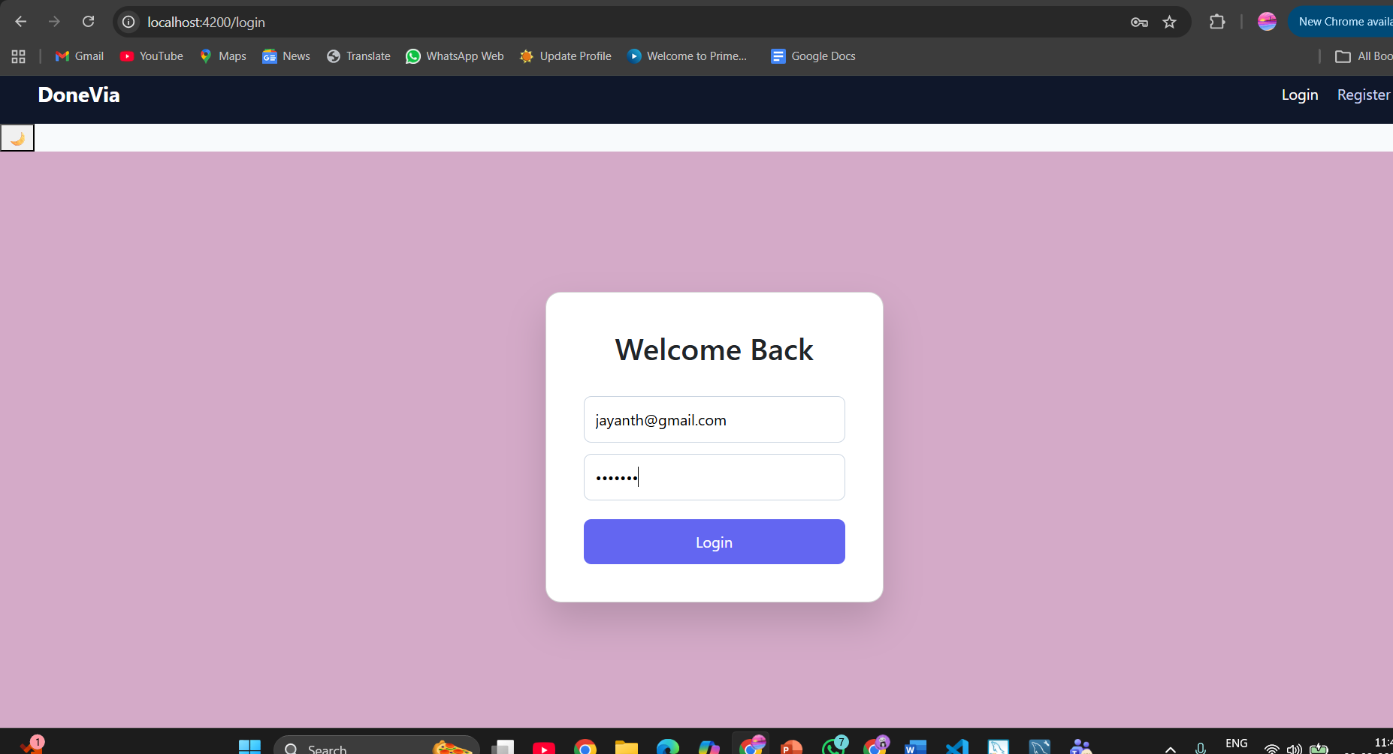
Frontend Implementation
Login Page
2024 - RPS Consulting all rights reserved

Slide 14
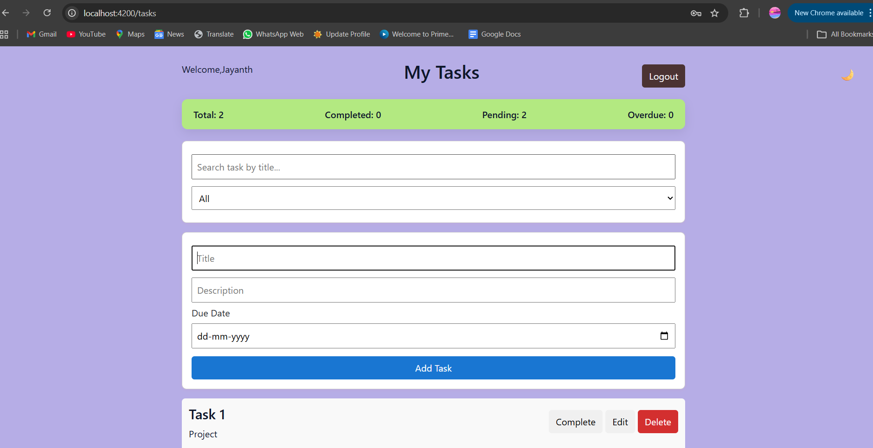
Frontend Implementation
Task List Page
2024 - RPS Consulting all rights reserved

Slide 15
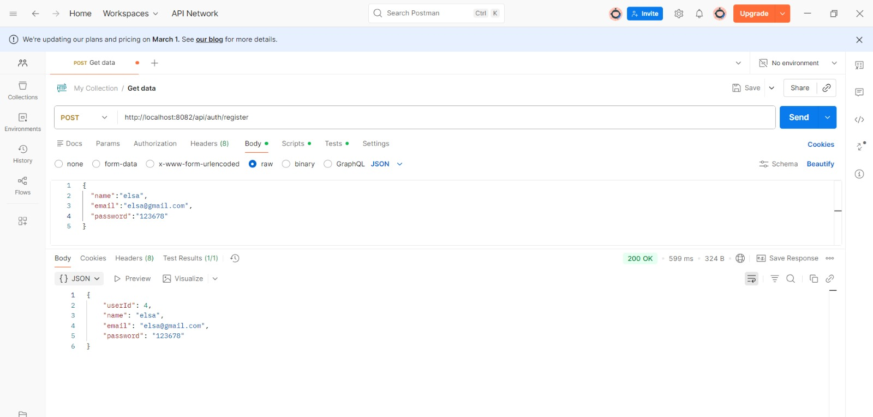
REST API Endpoints
POST /Api/auth/register – User register
2024 - RPS Consulting all rights reserved

Slide 16
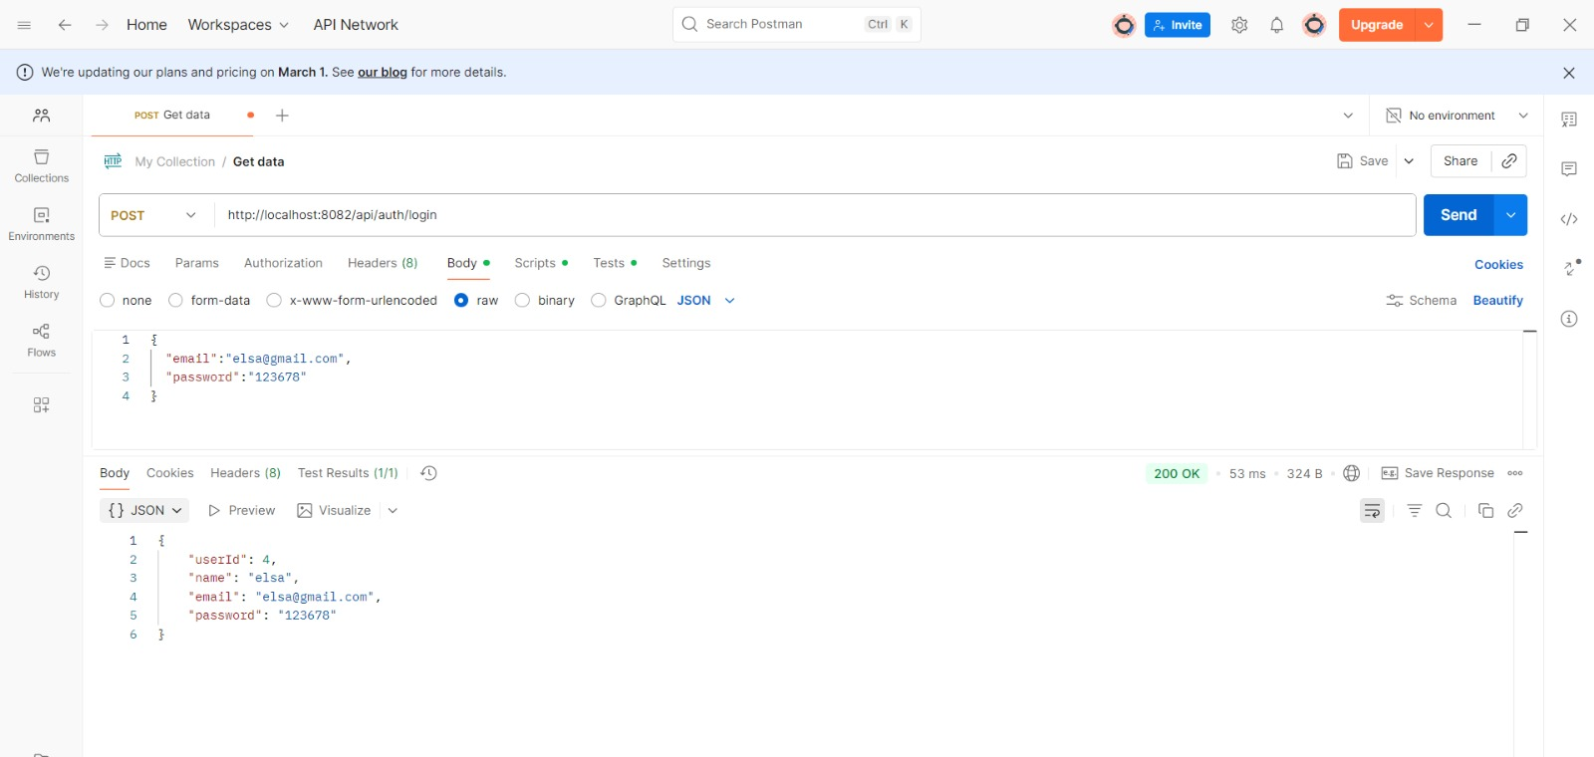
REST API EndPoints
POST /api/auth/login – User login
2024 - RPS Consulting all rights reserved

Slide 17
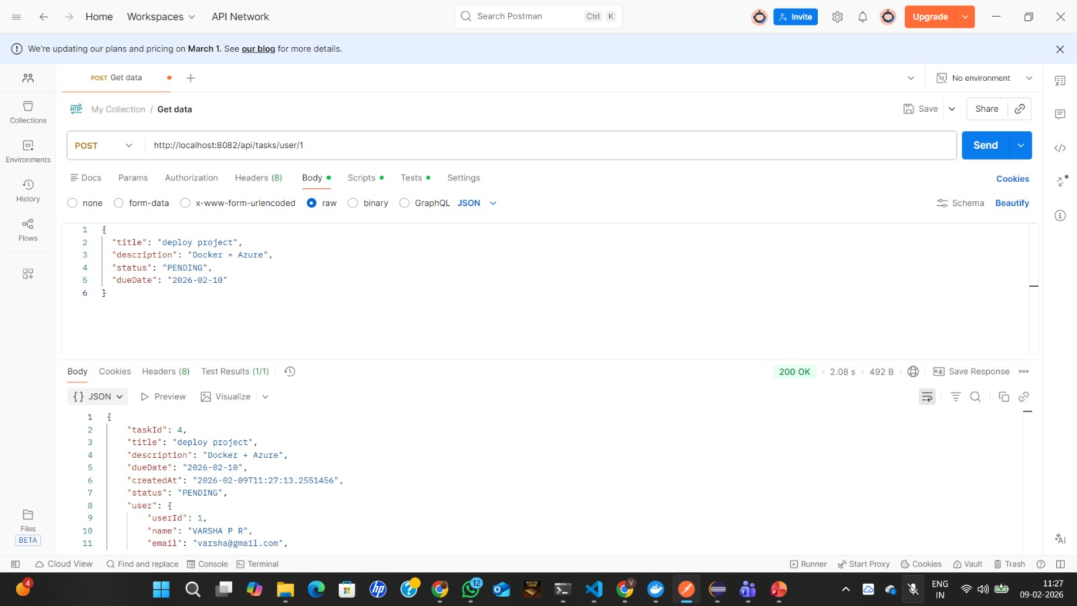
REST API EndPoints
POST /api/task/user/{userId} – Add task
2024 - RPS Consulting all rights reserved

Slide 18
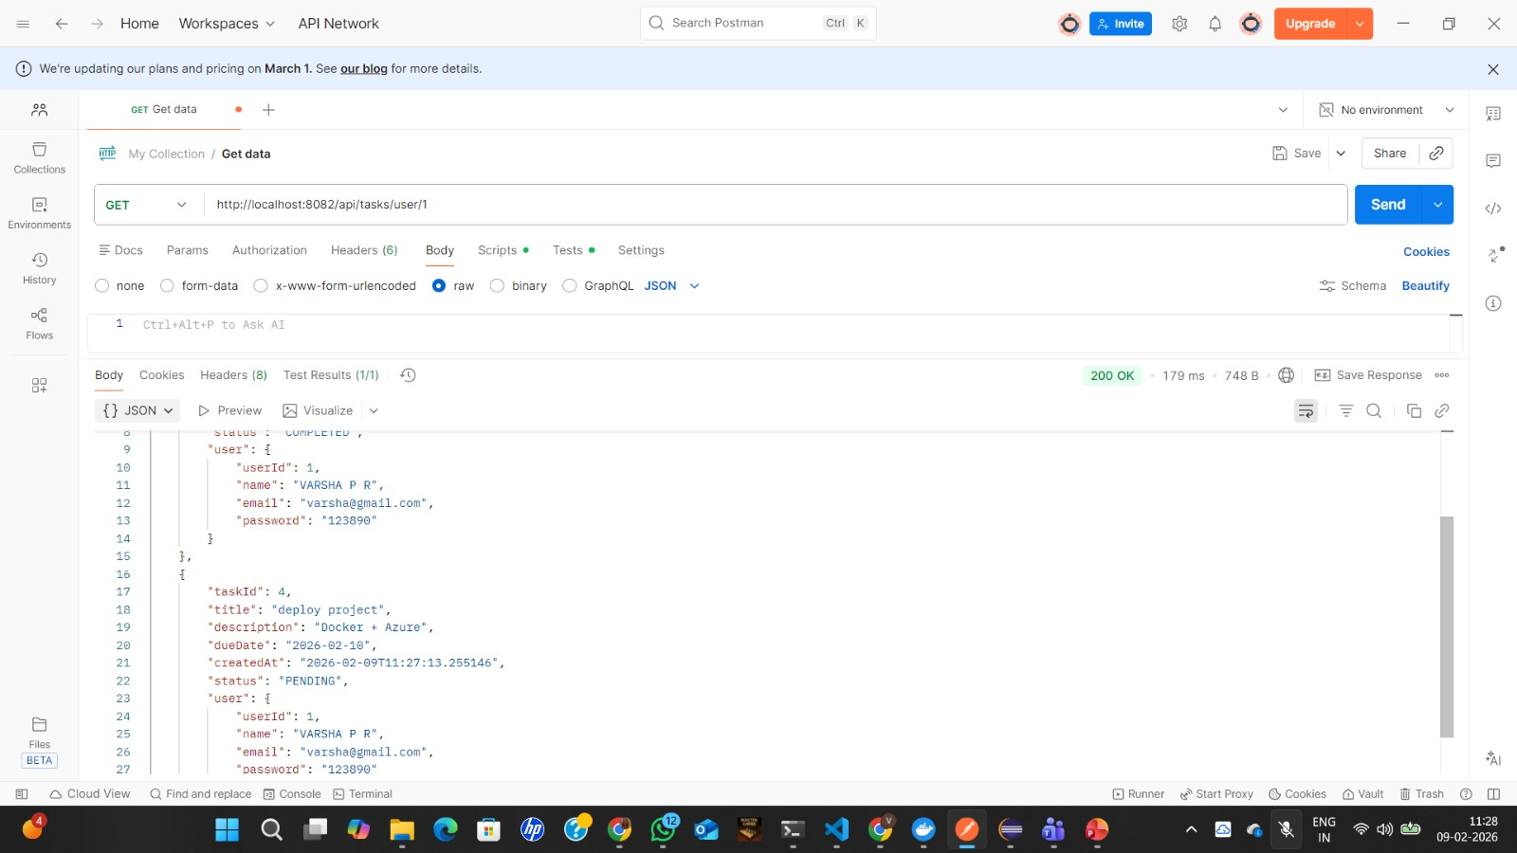
REST API EndPoints
GET /api/task/user/{userId} – Fetch tasks
2024 - RPS Consulting all rights reserved

Slide 19
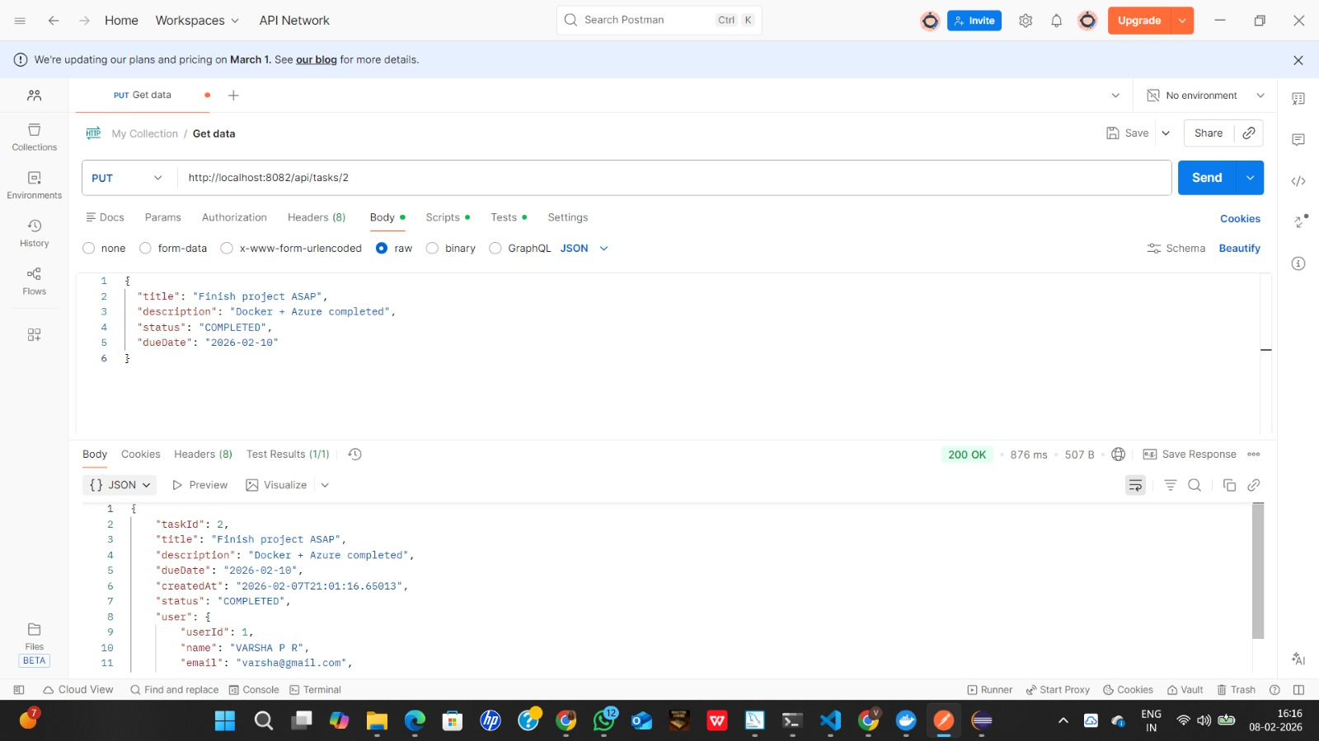
REST API EndPoints
PUT /api/task/user/{taskId} – Update task
2024 - RPS Consulting all rights reserved

Slide 20
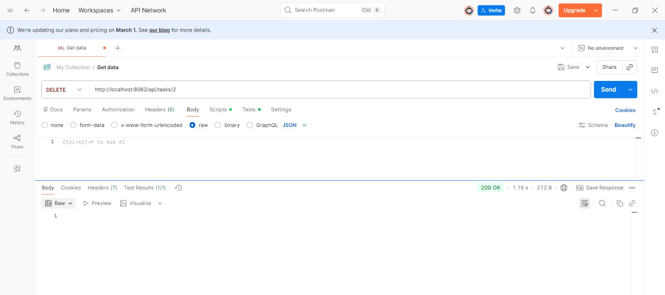
REST API EndPoints
DELETE /api/tasks/{taskId}– Delete task
2024 - RPS Consulting all rights reserved

Slide 21
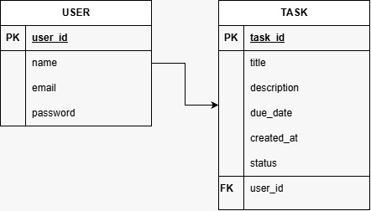
Database Design
Tables Used:
User
Task
Features:
One-to-many relationship (User → Tasks)
Stores task title, description, due date, and status
Uses MySQL for persistent storage
2024 - RPS Consulting all rights reserved

Slide 22
Docker Implementation
Created Docker file for backend
Docker image built successfully
Backend application packaged as JAR
Docker container created from image
Enables portability and consistency
2024 - RPS Consulting all rights reserved

Slide 23
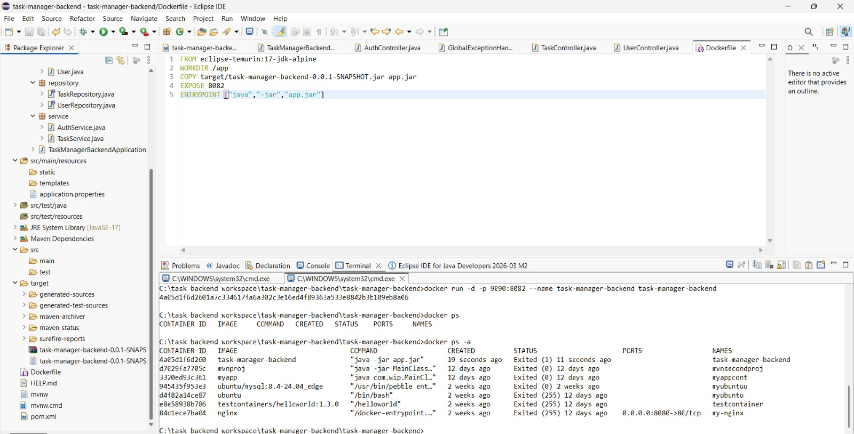
Docker Implementation
2024 - RPS Consulting all rights reserved

Slide 24
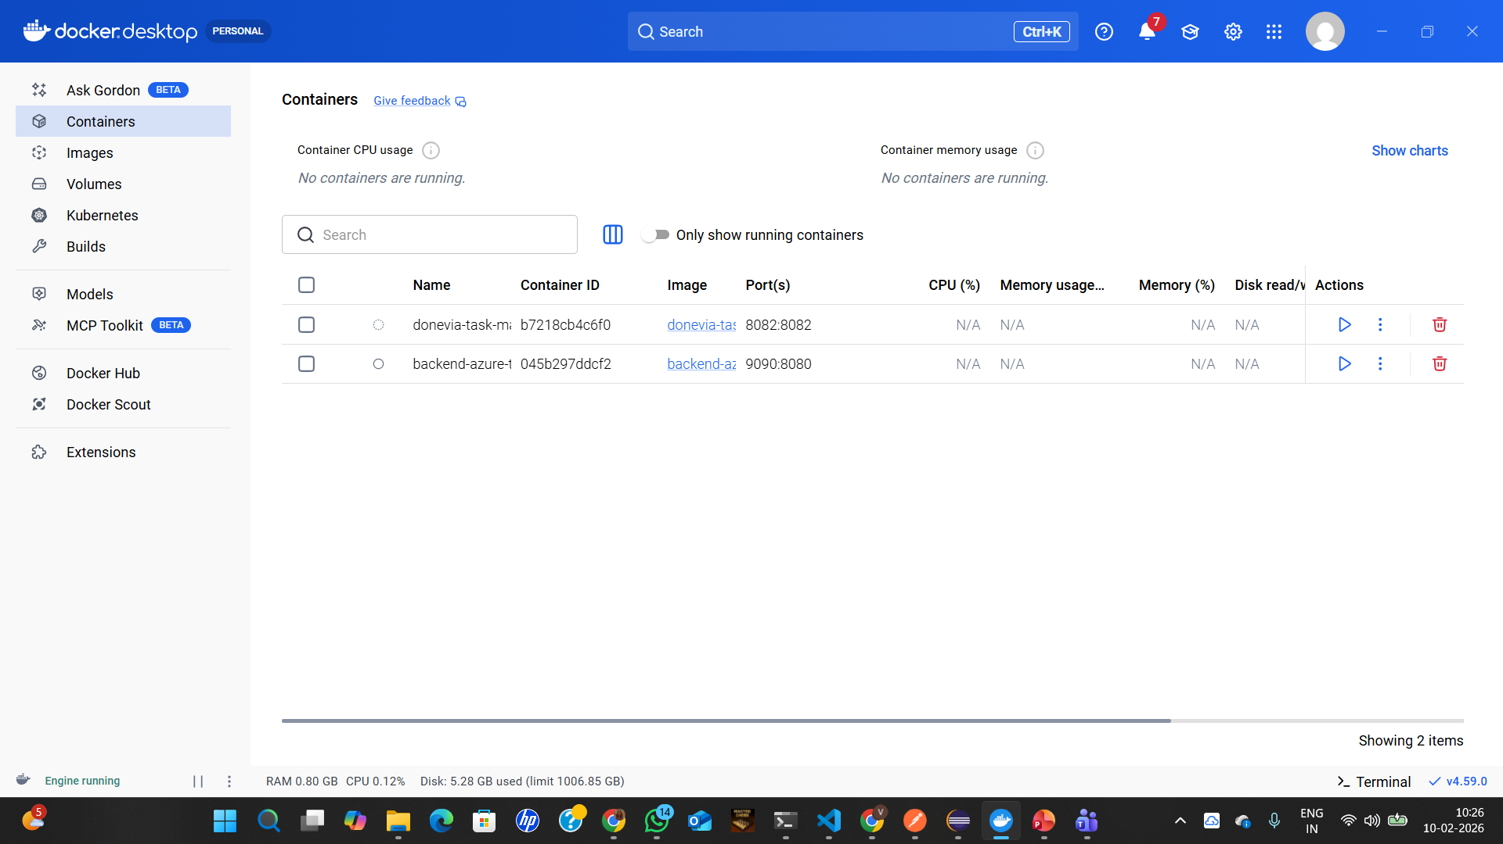
Docker Implementation
2024 - RPS Consulting all rights reserved

Slide 25
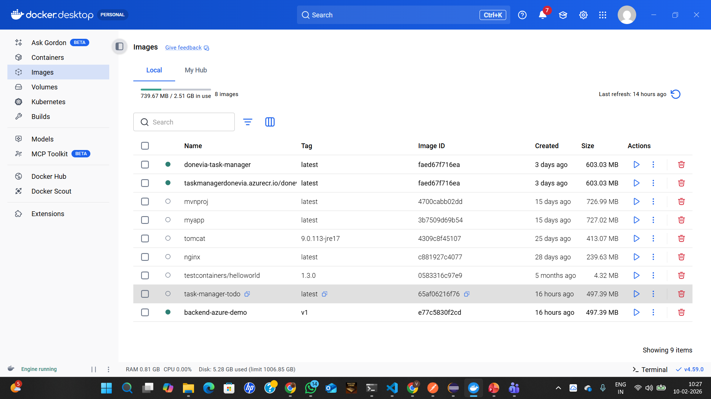
Docker Implementation
2024 - RPS Consulting all rights reserved

Slide 26
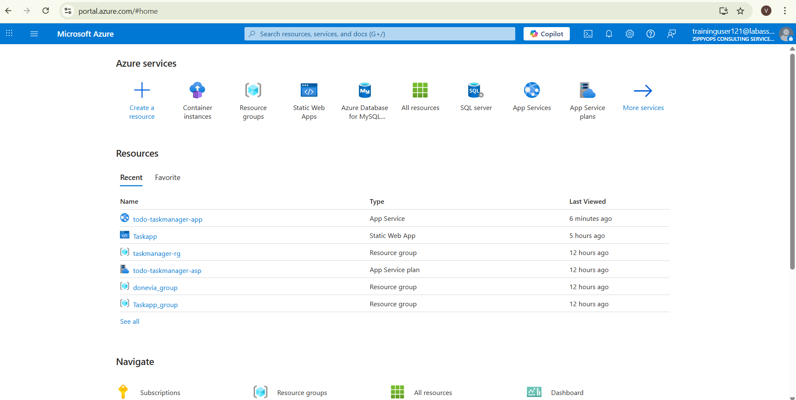
Azure Deployment
2024 - RPS Consulting all rights reserved

Slide 27
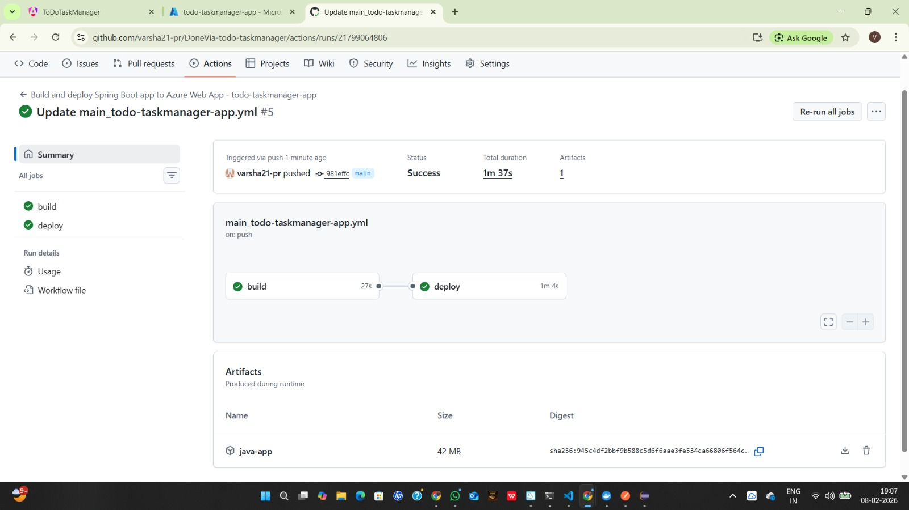
Azure Deployement
2024 - RPS Consulting all rights reserved

Slide 28
Source Code Management
GitHub used for version control
Proper project structure maintained
Meaningful commit messages
README file included with setup instructions
GitHub Link: https://github.com/varsha21-pr/DoneVia-todo-taskmanager.git
https://github.com/Jayanthvlk/To-do-List-Management-Application.git
2024 - RPS Consulting all rights reserved

Slide 29
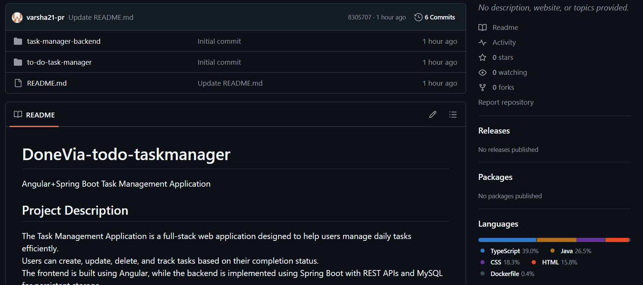
Source Code Management
2024 - RPS Consulting all rights reserved

Slide 30
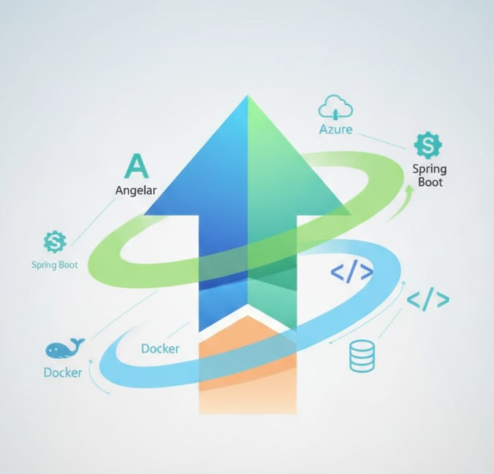
Learning Outcomes
Full-stack application development
REST API design using Spring Boot
Angular frontend development
Docker containerization
Azure cloud deployment
Debugging and problem-solving
2024 - RPS Consulting all rights reserved

Slide 31
Conclusion
This project successfully demonstrates the design and implementation of a full-stack Task Management Application using modern web and cloud technologies. The Angular frontend provides a responsive and user-friendly interface, while the Spring Boot backend exposes RESTful APIs to handle business logic and database operations. MySQL ensures reliable data storage, and all CRUD operations were validated using both the frontend and Postman. Docker was used to containerize the backend, ensuring consistency across environments, and Azure was used to deploy and host the application, reflecting real-world DevOps practices. Overall, the project showcases strong integration between frontend, backend, database, containerization, and cloud deployment, highlighting practical full-stack and DevOps skills applicable to industry-level applications.
2024 - RPS Consulting all rights reserved

Slide 32

2024 - RPS Consulting all rights reserved

